Slide 1



Deep Learning
Training Environment
Cloud Layer
Original data
DNN weight & bias
Original data
DNN weight & bias
Smart Gateway
Smart Gateway
LoRa Antenna
(SX1276)
LoRa Receipt
Program
Packet Forwarding program
LoRa Antenna
(SX1276)
LoRa Receipt
Program
Packet Forwarding program
container
sharing ledger
container
Message
Management Program
Message
Management Program
Fog Layer
DNN
container
BlockChain
container
DNN
container
BlockChain
container
Sensor data
Sensor data
Sensor Layer
LoRa Antenna
(SX1276)
Smart Meter Simulator
LoRa Antenna
(SX1276)
Smart Meter Simulator
Smart Meter Simulator
LoRa Antenna
(SX1276)
……

Slide 2
Smart Gateway
LoRa Antenna
(SX1276)
LoRa Receipt
Program
Packet Forwarding program
container
Message
Management Program
DNN
container
BlockChain
container

Slide 3
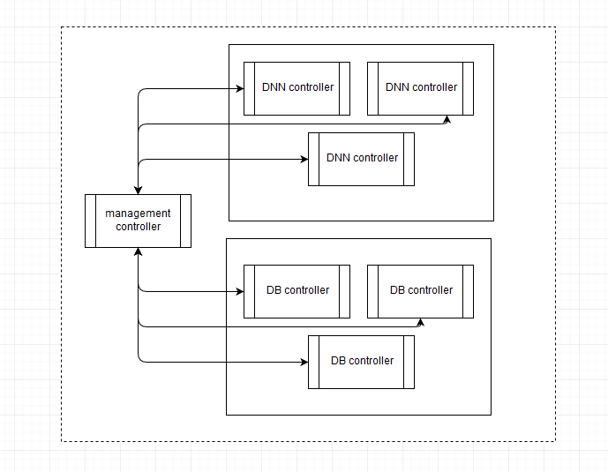
Docker Inner Network
6001
6002
Raspberry gateway
6003
6000
6004
BC
BC
6005
6006
BC

Slide 4
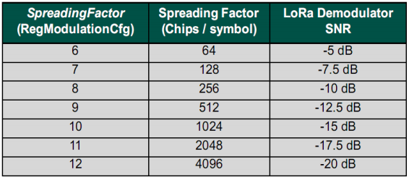

Slide 5
START
START
Dataset Normal 20000
Abnormal 20000
Dataset Normal 60000
Abnormal 60000
Testing Data 40000
Training and
Validation 120000
Load Model .Json, Weights in .h5
Into the Raspberry Pi
Model.compile(Adam, binary_crossentropy, Accuracy)
Predict(Model, Weights, Test data)
Model.fit(Batchsize=25, Epoch=100, Shuffle=True, Val_split=0.5)
Calculate the ACC, TPR, FPR
Save Model in .Json, Weights in .h5
Save the results
Copy Model & Weights to Raspberry Pi
END
END

